Slide 1

Data Driven Forecasting
SciScry - Overview
SciScry GmbH
Oct 2018
Munich

Slide 2
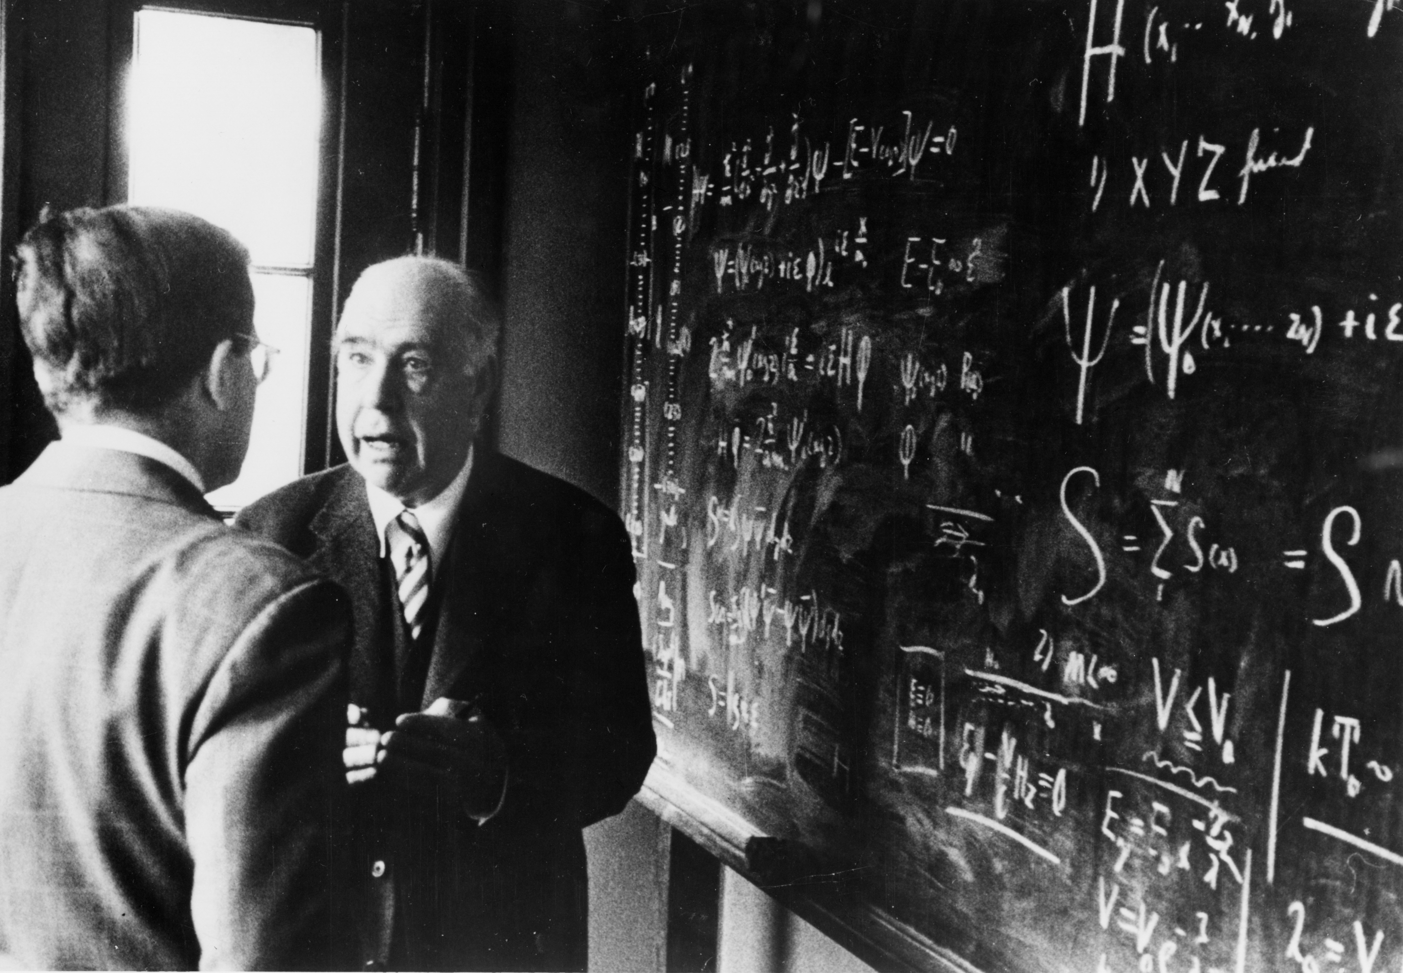
“Prediction is very difficult, especially about the future.”
Nils Bohr, Physicist

Slide 3
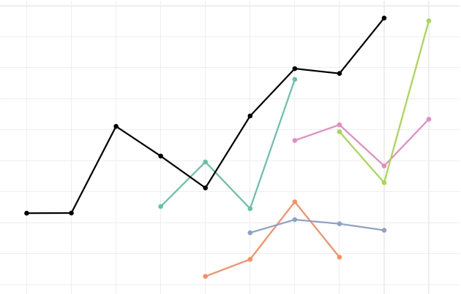
Looks familiar?
Forecasting Accuracy
Black Line – Actuals
Colored Lines – Manual Forecast
Revenue
Time
Notes:
Success Story ABB:
-Demand Planning in procurement using a rolling forecast for 2 years
-actuals were the basis for the analysis

Slide 4
Bad forecasts loose money and waste Resources
“Relying only on your own data to forecast is like navigating to a place you’ve never been to based on a map drawn by yourself only of places you already visited.”
Fabian Knust, Data Scientist
SciScry
Root issues of
inaccurate forecasts
“Many business only a have a very vague idea of the patterns that govern their business cycle.”
Philipp Beer, CEO
SciScry
“Not using a rigorous scientific approach to forecasting introduces all sorts of biases and mistakes into the prediction.”
Piero Ferrarese, Data Scientist
SciScry
WISHFUL THINKING
GUT FEELING
PROPRIETARY DATA ONLY
FEARS
HUMAN BIAS
FALSE INCENTIVES
FOCUS ON WRONG DRIVERS
FAST CHANGE OF GLOBAL ECONOMY
TOO MUCH INFORMATION

Slide 5
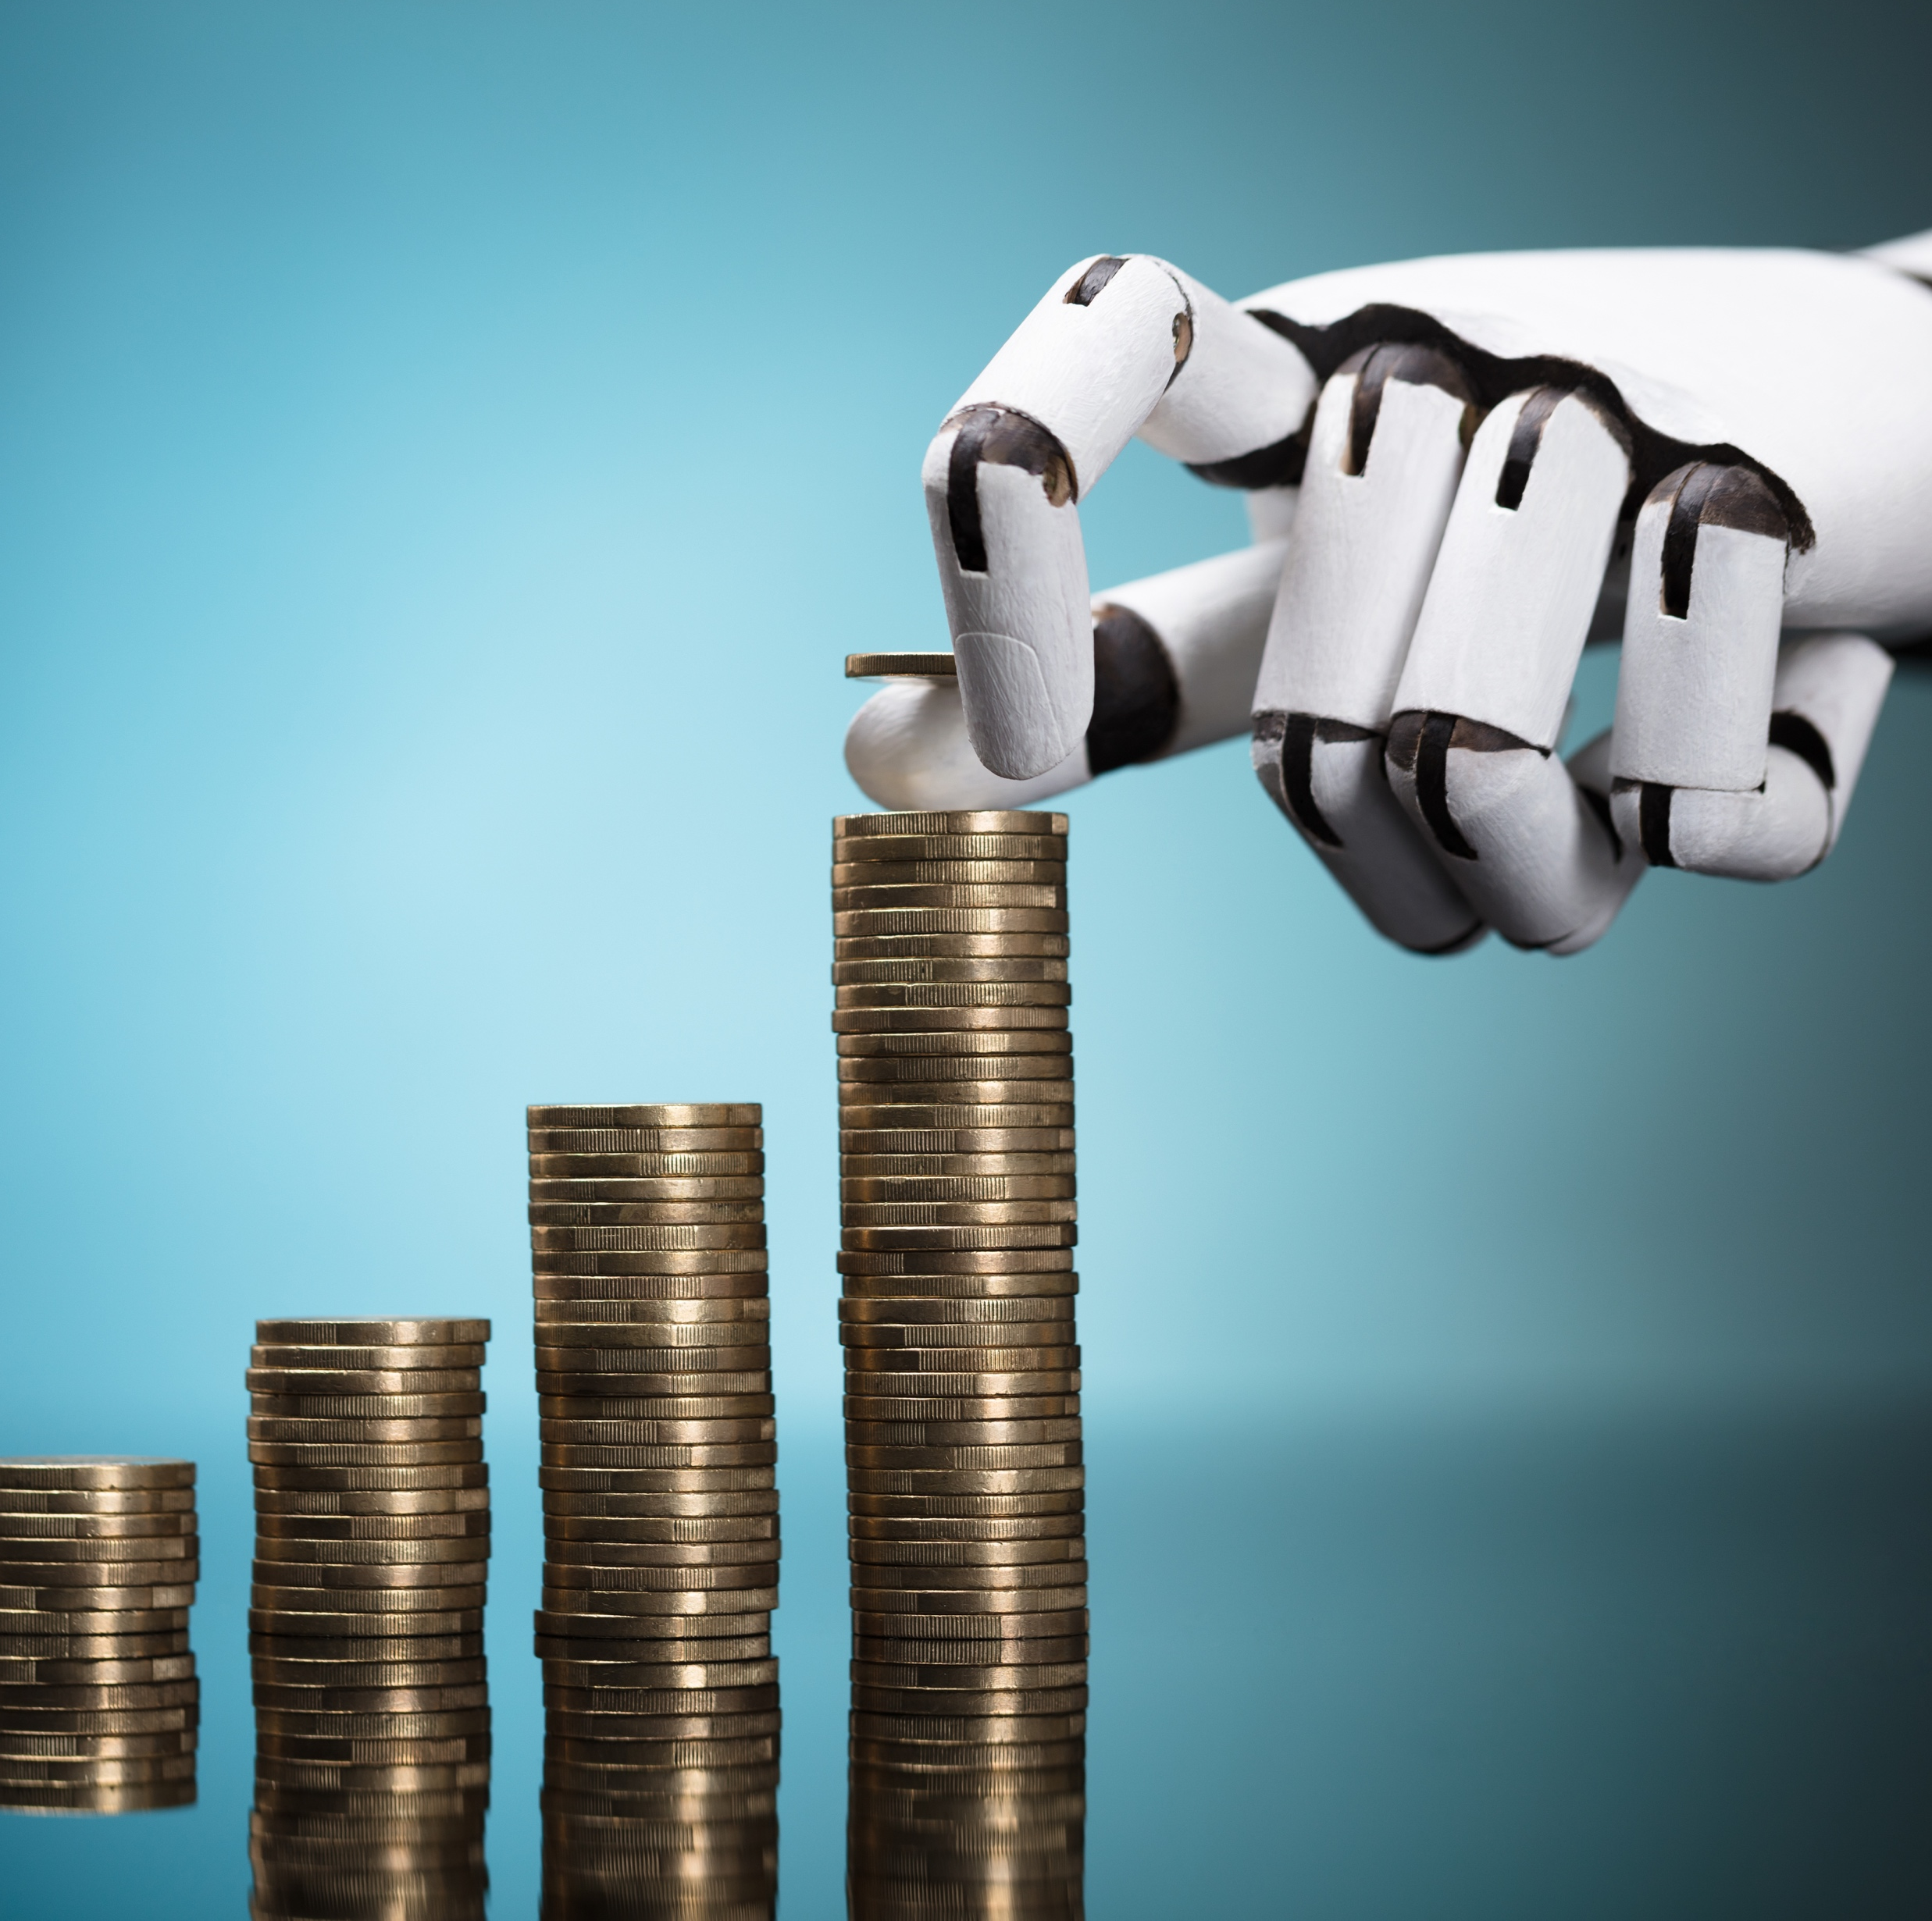


Unbeatable benefits of accurate forecasts
Improved Top & Bottom Line
Selling items customers love more and
Reduced inventory of items that require markdowns
Reduced
Working Capital
Achieving same or better outcome with less resources
Positive financial and physical impact
Helping our environment
Saving resources and minimizes pollution of our environment

Slide 6



SCISCRY – How to create great forecasts
Assumptions are the primary factor for decision making, while good forecasting insights are often not considered sufficiently.
SciScry offers access to the most advanced forecasting algorithms available. Customers connect their data to our cloud solution and generate meaningful and accurate forecasts for their most important KPIs.
Relevant 3rd party information can easily be integrated as domain knowledge to boost the forecasting performance of the algorithms.
Building on AI, machine learning as well as statistical methods, SciScry offers all relevant forecasting approaches and automatically selects the most advantageous model for each data set.

Slide 7
Our Features
Bring your data
To utilize the power of machine learning and AI all you need is to bring your data. We do the rest.
3rd Party Data
Numerous interfaces to 3rd party data platforms allow the integration of external data that help boost the accuracy of the models
Model Competition
We train multiple models and approaches and measure which ones are best to describe and forecast your data
MLaaS or on-premise
Our Solution is available in the cloud or as on-premise installation. It can be scaled from a laptop to a cluster.
Powerful Pre-Processing
Data Science to a large part requires data cleansing and preparation for machine learning. Our solution takes over most of the work.
Enterprise Ready
To enable seamless integration into your enterprise environment we offer a flexible API that allows you to integrate our forecasting results seamlessly

Slide 8
Use Case 1: Sales Forecast Retail Inc.
Oli, Sales Forecaster @ Retail Inc.
PLANNING LEVEL: Tactical | IMPACTS: Top-Line
As Sales Forecaster Oli has the challenge to provide an accurate forecast to Finance and Procurement per store affected by numerous local factors.
In the past her forecasts where primarily based on the inputs from the staff in the stores.
They are not well-trained in statistics, rely on their local data only and are incentivized by how much they achieve compared to their forecast.
Failing to provide accurate forecasts leads to:
missed sales opportunities,
reduced customer satisfaction and
negative financial consequences
Overestimations negatively impact working capital and profitability.
To low estimates generate unmet demand benefiting the competition.
With SciScry the relevant drivers in the historical data from Retail Inc. are identified and a more accurate forecast on store level is created.
In consequence Procurement has a better understanding of the required inventory for each store and the Finance department has more flexibility in the usage of their financial resources.

Slide 9
Use Case 2: Pharmacy Sales Forecast
Keira, Pharmacist @ Munich Pharmacy
PLANNING LEVEL: Tactical/Operational | IMPACTS: Top- & Bottom-Line
Keira runs her own pharmacy and has almost 20.000 different products in her multi-faceted product range.
She wants to serve her customers best by having the right products available in her inventory.
To achieve this she needs to have an inventory that considers seasonal fluctuations, epidemics with a product range that is diverse and expensive.
Failing to forecast the demand accurately leads to lower product availability and as well as unnecessary working capital binding.
In consequence Keira negatively impacts her customer satisfaction and needs to hold off on investments due to bound cash flow.
Using SciScry Keira gets the optimal forecasting method for each product in her range from classical statistical approaches to AI based methods.
Selected 3rd party data information, e.g. gtrends enable Keira to spot demand surges before the customers enter her pharmacy.
Notes:
Deductive Reasoning – From general to specific, e.g. all men are mortal. Harold is a man. Logical Conclusion: Harold is mortal.
Inductive Reasoning (opposite) – conclude general from specific observation
inductive inference (based on observations)
deductive inference (based on theory)
Another form of scientific reasoning that doesn't fit in with inductiveor deductive reasoning is abductive. Abductive reasoning usually startswith an incomplete set of observations and proceeds to the likeliestpossible explanation for the group of observations, according to ButteCollege. It is based on making and testing hypotheses using the bestinformation available. It often entails making an educated guess afterobserving a phenomenon for which there is no clear explanation.
For example, a person walks into their living room and finds torn uppapers all over the floor. The person's dog has been alone in the roomall day. The person concludes that the dog tore up the papers because itis the most likely scenario. Now, the person's sister may have broughtby his niece and she may have torn up the papers, or it may have beendone by the landlord, but the dog theory is the more likely conclusion.

Slide 10
Use Case 3: Business Outlook for Better Hair Inc.
Alek, CEO @ Better Hair Inc.
PLANNING LEVEL: Tactical | IMPACTS: Top-Line
As CEO Alek needs to provide accurate forecasts of the revenue growth of his public shampoo selling conglomerate to analysts during annual general meetings and quarterly earnings calls.
In the past his forecasts where based on the best knowledge of his staff, but not necessarily validated by the patterns and trends hidden inside the historical corporate data.
Being outside of the guidance provided through official investor communication:
Hurts stock price
Creates mistrust and
Harms investors confidence
Implement the SciScry forecasting solution identifying and fine-tuning the best-suited models that describe data patterns and trends optimally.
As outcome, Alek not only receives an unbiased forecast but confidence intervals that allow him to provide upper and lower bounds for his guidance.
With his CEO superpower of human intuition he can argue the plausibility of each scenario.
Notes:
Deductive Reasoning – From general to specific, e.g. all men are mortal. Harold is a man. Logical Conclusion: Harold is mortal.
Inductive Reasoning (opposite) – conclude general from specific observation
inductive inference (based on observations)
deductive inference (based on theory)
Another form of scientific reasoning that doesn't fit in with inductiveor deductive reasoning is abductive. Abductive reasoning usually startswith an incomplete set of observations and proceeds to the likeliestpossible explanation for the group of observations, according to ButteCollege. It is based on making and testing hypotheses using the bestinformation available. It often entails making an educated guess afterobserving a phenomenon for which there is no clear explanation.
For example, a person walks into their living room and finds torn uppapers all over the floor. The person's dog has been alone in the roomall day. The person concludes that the dog tore up the papers because itis the most likely scenario. Now, the person's sister may have broughtby his niece and she may have torn up the papers, or it may have beendone by the landlord, but the dog theory is the more likely conclusion.

Slide 11
Use Case 4: DOMESTIC WATER DEVELOPMENT
Elon, Infrastructure Planner @ Munich City
PLANNING LEVEL: Strategic | IMPACTS: City Attractiveness
Elon works for the infrastructure planning department in Munich. For a modernization project he is asked to provide an outlook on the wastewater generation of private households.
Based on his prognosis a decision on the capacity of the sewage conduit of an old part of the town is made.
Significant forecast deviation will result in a mal-functioning sewage system.
Large additional costs in maintenance and infrastructure adjustments are the costs.
When integrate with relevant 3rd party data (e.g. demographic change and water consumption) more accurate predictions can be made and provide better view of future infrastructure needs.

Slide 12
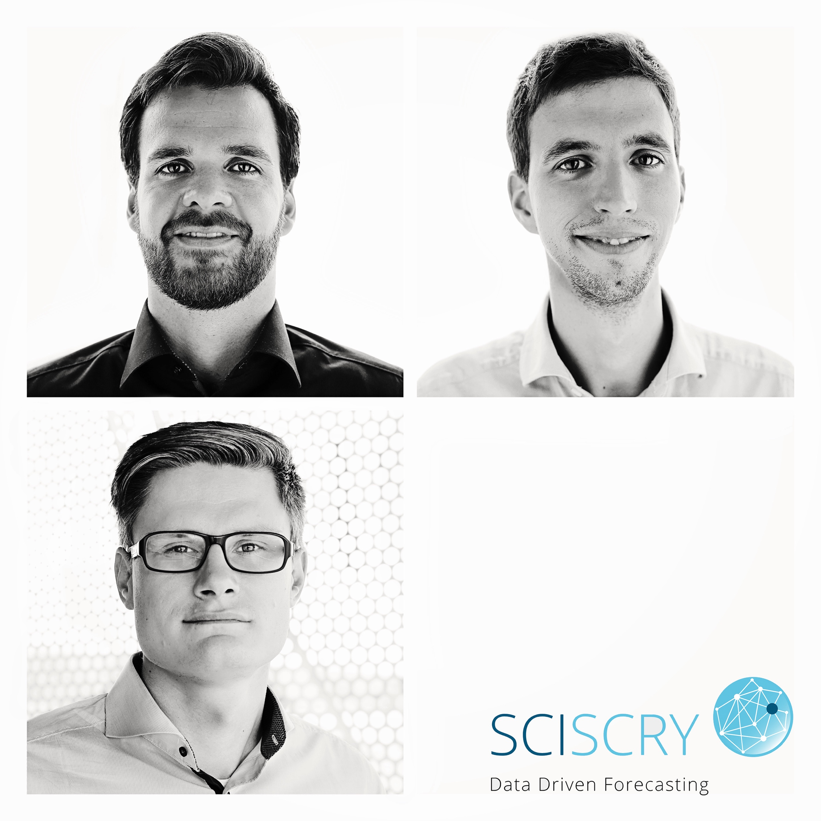
Sciscry core team
Fabian holds a Ph.D. in extraterrestrial physics with a strong data science background.
At SciScry he focuses on the implementation of machine learning algorithms as well as the system architecture.
Piero holds a Ph.D. in theoretical particle physics with a strong data science background.
At SciScry he focuses on the implementation of machine learning algorithms and model validation.
Philipp is an experienced entrepreneur and former consultant optimizing planning and forecasting processes at large enterprises.
At SciScry he focuses on all business aspects.
„We help you see today, what is going to happen tomorrow.“
- SciScry Mission

Slide 13

SciScry GmbH
Johanna-Hofer-Weg 20 • 81739 München
Tel.: +49 (0) 89 / 998 20 84 81
info@sciscry.ai • sciscry.ai

